Slide 1
How to read from a file read, readline, reader
Susan Ibach | Technical Evangelist
Christopher Harrison | Content Developer

Slide 2
Writing something down to remember it is only helpful if you can read it when you need it later!
Reading a shopping list at the grocery store so you know what to buy
Checking the number of guests on a guest list so you can see if you have enough food
Looking up a phone number so you can call someone

Slide 3
In programs we often have to read information that was saved in files
When you start your e-book reader, it looks up what page you were on when you last shut down
When you start up your game, it looks up what treasures you had already collected so you can pick up where you left off
There all also thousands of interesting OpenData files out there you can read to find out cool information you can use in your programs. For example: you can find out what fauna they have at the museum in Tasmania (You would be amazed at the data files you can find on the internet!)

Slide 4
Text files

Slide 5
How do we read a file with code?
Use the open function
myFile = open(fileName, accessMode)
Look familiar? Yes, it’s the same method we use to write to a file
So how does the program know whether to read or write?
The access mode
Access mode | Action
r | Read the file
w | Write to the file
a | Append to the existing file content
b | Open a binary file

Slide 6
How do you read the file contents?
Use the read method
fileContent= myFile.read()
The read method will return the entire contents of the file into the specified string variable

Slide 7
If you prefer you can read one line at a time
Use the readline method
fileContent= myFile.readline()
The readline method will return one line from the file

Slide 8
Read a file

Slide 9
CSV files

Slide 10
If you are reading a CSV file, there is a csv library that will help you!
To access the features in the csv library you must import it
import csv

Slide 11
Now you can use the reader function to return all the rows from the file into a list
The reader function will take an open csv file and return each row from the file into a list
dataFromFile = csv.reader(myCSVfile)
If your file is not using a comma to separate the values, you can tell the reader function what character is used as a delimiter
dataFromFile = csv.reader(myCSVFile, delimiter=",")

Slide 12
Now we can open and read a csv file
fileName = "GuestList.txt“
accessMode = "r"
with open(fileName, accessMode) as myCSVFile: #Read the file contents
dataFromFile = csv.reader(myCSVFile)

Slide 13
Why do we have a ‘with’ and ‘:’ ?
with open(fileName, accessMode) as myCSVFile:
Programs should always open a file, and close it when they are done
If they don’t sometimes the code crashes when you try to re-open a file that wasn’t closed last time you ran your code
The ‘with’ ‘:’ syntax is used for certain methods to make sure clean up code such as close file runs even if there is an error.

Slide 14
Once we have all the rows from the csv files returned, how do we access the individual rows?
Use a for loop to loop through the values in the list
Each row will be one value
with open(fileName, accessMode) as myCSVFile:
#Read the file contents
dataFromFile = csv.reader(myCSVFile)
#For loop that will run once per row
for row in dataFromFile :
print(row)

Slide 15
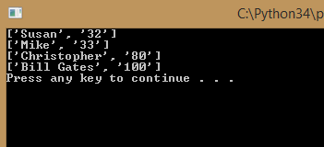
Put it all together and it looks something like this
fileName = "GuestList.txt"
accessMode = "r"
with open(fileName, accessMode) as myCSVFile:
#Read the file contents
dataFromFile = csv.reader(myCSVFile)
#For loop that will run
#once per row
for row in dataFromFile :
print(row)

Slide 16
Read a CSV file

Slide 17
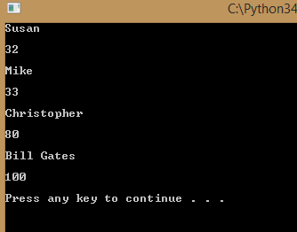
What if I want to access an individual value from a row and not just print the whole row?
The row returned in the loop is actually a list of the words in that row
for row in dataFromFile :
print(row)
for value in row :
print(value + "\n")
So you can just create a nested loop to loop through the words in the row

Slide 18
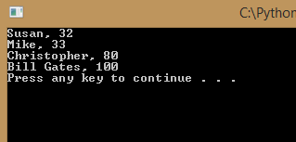
But I don’t like those square brackets and quotes it added to the rows!
You can use the join function to format the output
SeparatorToDisplay.join(myList)
for row in dataFromFile :
print (', '.join(row))

Slide 19
Reading individual values from a CSV file

Slide 20
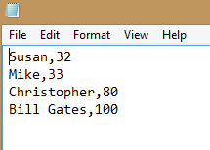
Your challenge
Write a program that will print the names and ages of the guests in the guest list file you created in the last module
If you didn’t do the last challenge, you can just create a file to read using Notepad that contains names and ages

Slide 21
Congratulations
You can now write a program that can receive or retrieve information from a file!

